Slide 1
Food Delivery Time Estimation
Team members:
Kevin Chou 117393248
Daniel Huang 117684681

Slide 2
Agenda
Data Cleaning
Modeling
Result Analyzing

Slide 3
Data Cleaning

Slide 4
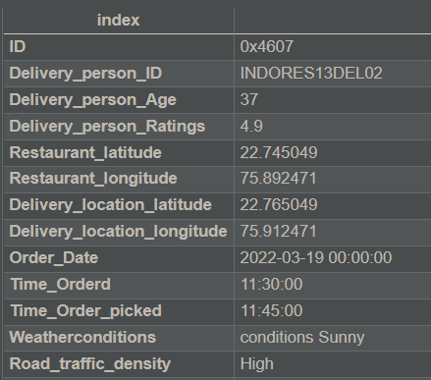
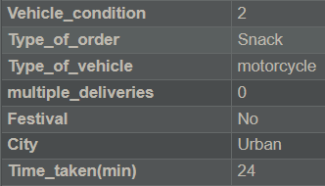
Original Data
Notes:
Vehicle_condition(0-3)
Time_taken(10-54)
Type of order['Snack ', 'Drinks ', 'Buffet ', 'Meal ']
Type of vehicle['motorcycle ', 'scooter ', 'electric_scooter ', 'bicycle ']

Slide 5
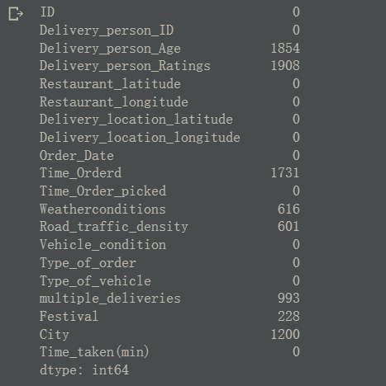
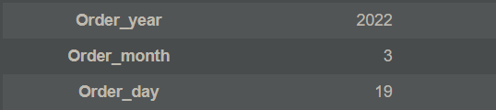
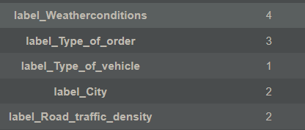
Replace “NaN” with np.nan, then drop NA. | Transfer Order_Date to Datetime and split to year,month and day. | Label Encoded Categorical columns
Notes:
56992 count

Slide 6
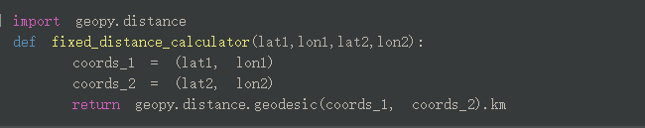
Feature engineering for Longitude and Latitude.
Get the direct distance from the Longitude and Latitude.

Slide 7
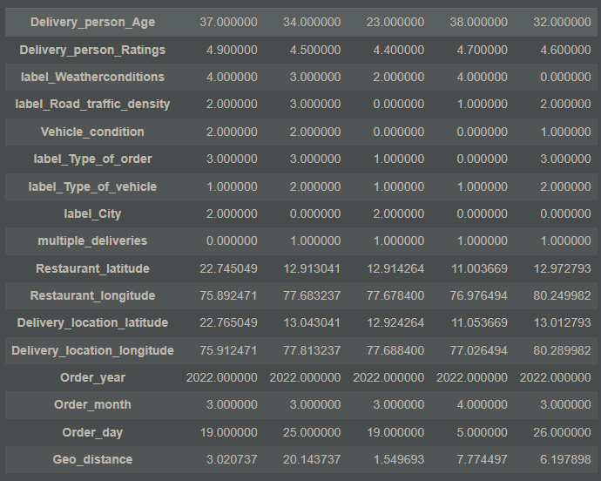
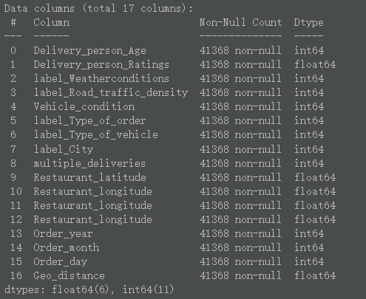
Final Result

Slide 8
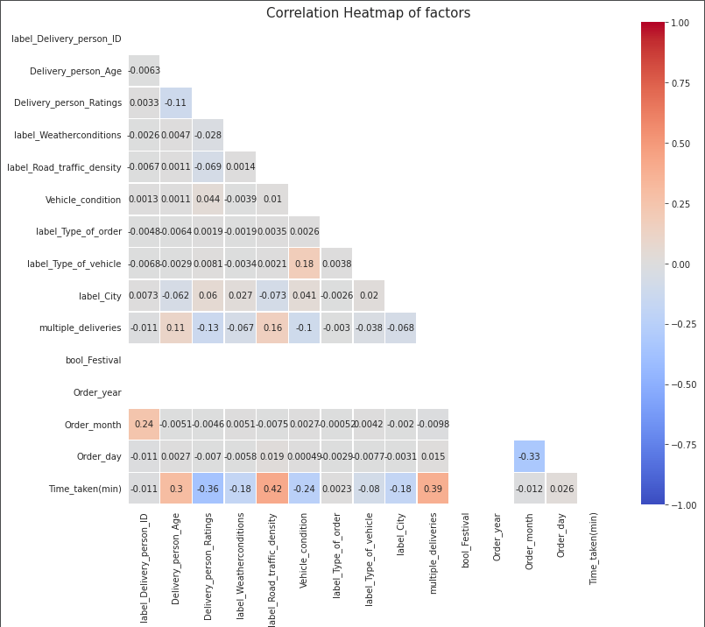

Slide 9
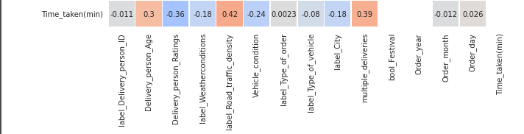

Slide 10
Split by test 33% and train 67 %.
X_train, X_test, y_train, y_test = train_test_split( X, y, test_size=0.33, random_state=42)

Slide 11
Modeling

Slide 12
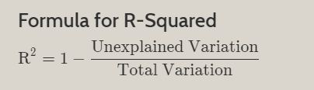
Modeling
Goal: Estimate the “delivery time”.
Algorithms:
LassoLars
DecisionTreeClassifier
SVC
XGBRegressor
RandomForestRegressor
Our Method is R2 Score.
Notes:
Use both linear and
Evaluate method is R2.

Slide 13
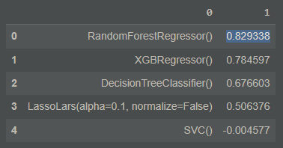
The best model is Random Forest Regressor.
Notes:
When the model are worse than a constant function that always predicts the mean of the data, the R2 will be negative.

Slide 14
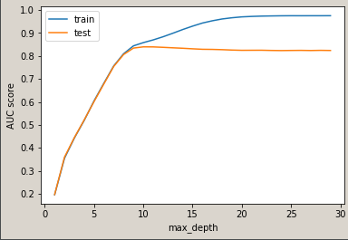
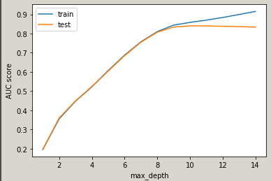
Tuning Tree Depth
Notes:
To tune the parameter, we plot out the results for different tree depth.
As we can see from the plot, the best result will reach around the depth of 10.

Slide 15
GridSearchCV
Try all the hyper-parameters and store in a grid.
Retrieve best model by grid_results.best_estimator_ and best hyper-parameters by grid_results.best_params_
Notes:
GridSearchCV implements a “fit” and a “score” method. It also implements “score_samples”, “predict”, “predict_proba”, “decision_function”, “transform” and “inverse_transform” if they are implemented in the estimator used.
We can retrieve the best model by calling best_estimator and get best parameter set by best_params

Slide 16
Use GridSearchCV to Tune the Parameters.
parameters:
"n_estimators":[x for x in range(5,10,1)], the number of trees you want to build
'max_depth': [8,9,10], The maximum depth of the tree.
'max_features': ['auto', 'sqrt'], The number of features to consider when looking for the best split
"min_samples_split":[1, 2, 4], The minimum number of samples required to split an internal node
"min_samples_leaf":[2, 5, 10] The minimum number of samples required to be at a leaf node.
}
Notes:
To go even more we tried GridSearchCV to help us investigate

Slide 17
Best Model
Accuracy:0.8362683766167592,
max_depth: 10,
max_features: auto,
min_samples_leaf: 2,
min_samples_split: 4,
n_estimators: 9

Slide 18
Result Analysis

Slide 19
Analyze Tool: SHAP
(SHapley Additive exPlanations)
Study single case (Force Plot)
Also for single case (Waterfall Plot)
Look into the decision made by the Random Forest Regression (Decision Plot)
Look into all the distributions of all parameters (BeesWarm Plot)
Notes:
SHAP and LIME
Both are really popular Visualization tool, but I personally like shap more.
SHAP (SHapley Additive exPlanations) is a game theoretic approach to explain the output of any machine learning model.
Below we will be going throught 4 different plots we have tried in this project

Slide 20
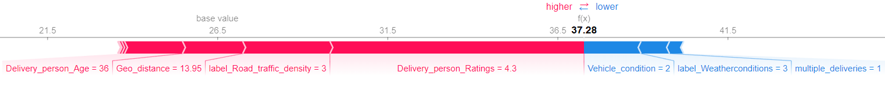
Force Plot
Red means larger value
Blue means lower value
choosen_instance = X_test.loc[[301]]
shap_values = explainer.shap_values(choosen_instance)
shap.initjs()
shap.force_plot(explainer.expected_value[0], shap_values[0], choosen_instance)
Notes:
The SHAP force plot shows the most influence on the model’s prediction for a single test case.
Rating for delivery people could see that one 4.8 is high 4.3 is consider low
Weather condition 0 means bad 5 means good
foggy, storm, rain, windy, Sunny, cloud
The features that were important to making the prediction for this observation are shown in red and blue, with red representing features that pushed the model score higher, and blue representing features that pushed the score lower.

Slide 21
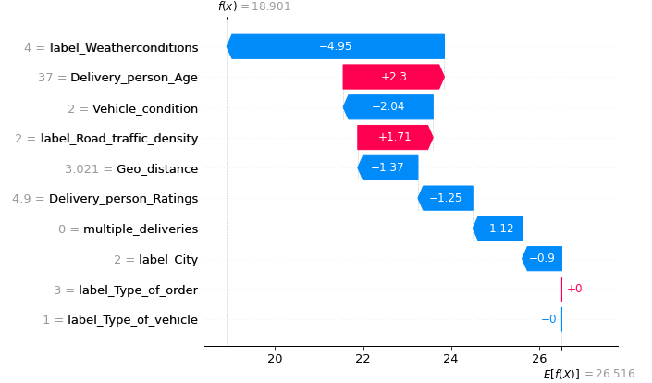
WaterFall Plot
Red means larger value
Blue means lower value
Notes:
This is the waterfall plot which give us a clear picture of how does every parameters affect the final estimation individually
Weather_condition, delivery_age

Slide 22
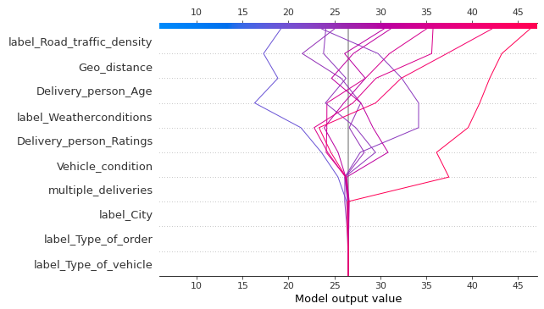
Decision Plot
Red means larger value
Blue means lower value
Notes:
Decision Plot basically is listing out all the decisions that made by the Random Forest Regression model. As you can see that this graph clearly shows that which decision affect the delivery time for the
The highest time the model will be predicted
And the lowest time the model will be predicted

Slide 23
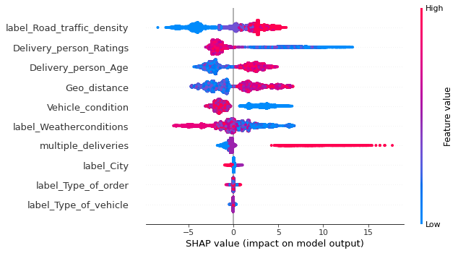
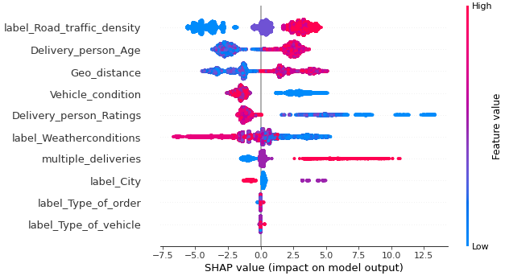
BeesWarm Plot
Random Forest Regression XGBoost Regression
Red means larger value
Blue means lower value
Notes:
The beeswarm plot is designed to display an information-dense summary of how the top features in a dataset impact the model’s output. Each instance the given explanation is represented by a single dot on each feature fow.
Positive Correlation
Order
The x position of the dot is determined by the SHAP value of that feature, and dots “pile up” along each feature row to show density. Color is used to display the original value of a feature

Slide 24
Citations
https://www.investopedia.com/terms/r/r-squared.asp
https://scikit-learn.org/stable/modules/generated/sklearn.model_selection.GridSearchCV.html
https://analyticsindiamag.com/hands-on-guide-to-interpret-machine-learning-with-shap/#:~:text=Shap%20values%20are%20arrays%20of,row%20corresponding%20to%20each%20feature.
https://medium.com/mlearning-ai/shap-force-plots-for-classification-d30be430e195

Slide 25
Thanks for your patient

